Slide 1


<Insert Picture Here>
16 3D Support
Solids, Point Clouds, Tins

Slide 2
Agenda
Concepts
Using the Z
3D Coordinate Systems
Modeling 3D Objects
3D Queries
From 2D to 3D: Extrusions
Publishing 3D objects: cityGML, KML
Point Clouds and Tins
Data models
Loading and clipping

Slide 3
What does 3D support cover ?
Using the Z
3D Coordinate systems
Modeling 3D objects
Points, lines, polygons with Z
Surfaces and solids
Capturing the reality
New specialized types
Point clouds resulting from laser scanning
Triangulated surfaces (TINs)

Slide 4
<Insert Picture Here>
3D Coordinate Systems

Slide 5
2D Coordinate Systems
There are two kinds of 2D systems:
Geographic 2D
Example: SRID 4326 (Longitude/Latitude WGS 84)
Projected 2D
Example: SRID 27700 (OSGB 1936 / British National Grid)

Slide 6
3D Coordinate Systems
There are two kinds of 3D systems:
Geographic 3D
Based on longitude and latitude, plus ellipsoidal height
The ellipsoidal height is the height relative to a reference ellipsoid, which is an approximation of the real Earth
Example: SRID 4327 (Longitude/Latitude WGS84 3D)
Compound Systems
Based on a geographic or projected two-dimensional system, plus gravity-related height
Example: SRID 7405 (OSGB36 / British National Grid + ODN)
Combines SRID 27700 (horizontal 2D projection) and SRID 5701 (vertical component)

Slide 7
Vertical Systems
Gravity-related height : the height as influenced by the Earth's gravitational force, where the base height (zero) is an equipotential surface
The height of any point is an approximation of its distance above or below "sea level“
Example: SRID 5701 (Ordnance Datum Newlyn)
Based on Mean Sea Level at Newlyn (Cornwall) between 1915 and 1921.

Slide 8
Getting Information about 3D systems
Must search the full data model.
Table SDO_COORD_REF_SYSTEM (actually a view)
select srid, coord_ref_sys_name,coord_ref_sys_kind
from sdo_coord_ref_system
where srid in (4326, 4327, 27700, 5701, 7405);
SRID COORD_REF_SYS_NAME COORD_REF_SYS_KIND
----- ------------------------------------- ------------------
4326 WGS 84 GEOGRAPHIC2D
4327 WGS 84 (geographic 3D) GEOGRAPHIC3D
5701 Newlyn VERTICAL
7405 OSGB36 / British National Grid + ODN COMPOUND
27700 OSGB 1936 / British National Grid PROJECTED
5 rows selected.

Slide 9
How is a Compound System Formed ?
select coord_ref_sys_name, cmpd_horiz_srid, cmpd_vert_srid
from sdo_coord_ref_system
where srid = 7405;
COORD_REF_SYS_NAME CMPD_HORIZ_SRID CMPD_VERT_SRID
---------------------------------------- --------------- --------------
OSGB36 / British National Grid + ODN 27700 5701
1 row selected.

Slide 10
Creating a New Compound System
insert into sdo_coord_ref_system (
srid, coord_ref_sys_name, coord_ref_sys_kind,
cmpd_horiz_srid, cmpd_vert_srid, is_legacy
)
values (
314685783,
'DHDN / Gauss-Kruger zone 4 + DHHN92 height',
'COMPOUND',
31468,
5783,
’FALSE'
);
commit;

Slide 11
Conversions: 2D <-> 3D
SDO_CS.MAKE_3D(geometry, Z, srid)
Adds the specified Z value for each vertex (0 if not specified)
Use the specified 3D SRID for the result (or keep original 2D SRID)
SDO_CS.MAKE_2D(geometry, srid)
Removes all Z from the geometry
Use the specified 2D SRID for the result (or keep original SRID)
Applies only to simple 3D shapes
Points, lines, polygons (= simple surfaces = faces)

Slide 12
<Insert Picture Here>
Migrating from Earlier Release

Slide 13
Validating 2½D structures
Specific 3D rules applied
In 11.2.0.2 and 11.2.0.3: geometries must have a 3D SRID !
Apply patch 10296467 (VALID GEOMETRY IS CONSIDERED INVALID WHEN USING COMPOUND CS)
Or validate in 2D:
Or use the “10g compatibility” mode:
ORA-54668: a 2D SRID cannot be used with a 3D geometry
SDO_GEOM.VALIDATE_GEOMETRY_WITH_CONTEXT (
SDO_CS.MAKE_2D(geometry), 0.05
)
SDO_GEOM.VALIDATE_GEOMETRY_WITH_CONTEXT (
geometry, 0.05, NULL, ‘TRUE’
)
Use 10g rules (ignore 3D)

Slide 14
Validating 2½D structures
Specific 3D rules applied
Arcs are not allowed !
Lines: points with same X and Y but different Z are no longer considered as duplicates !
Simple Surfaces: must be planar !
3D validation is more expensive (CPU)

Slide 15
Remove Unnecessary Z values
Data that is not really 3D
Shapes with Z set to 0 or NULL
Common for data imported from CAD systems
Horizontal shapes
Lines or polygons with all Z identical
Are the Z really used by the application ?
Convert them to 2D with SDO_CS.MAKE_2D(geometry)
Removes the Z values

Slide 16
Queries on 2½D data
Now performed using 3D rules!
Two 2 ½ lines with different Z no longer intersect !
3D queries are much slower than 2D queries
No internal optimizations!
Use 2D spatial index
Will now use 2D rules for queries (Z are ignored)
This is the default!

Slide 17
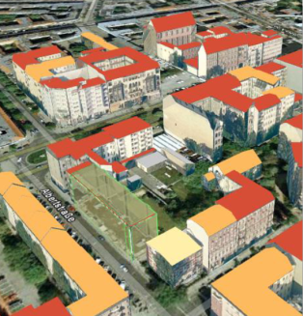
<Insert Picture Here>
3D Data Structures

Slide 18
Exploiting the Z in “classic” geometries
Point
X, Y, Z
Line
Suite of points X,Y,Z
Polygon = Simple Surface = Face
All points must be in the same plane
A simple surface can have any polygonal shape (possibly with voids)
Only straight lines or rectangles (no arcs or circles)
Any orientation
But holes must have the opposite orientation to the outer ring

Slide 19
SDO_GEOMETRY – Classic Types
Object Type | GTYPE | ETYPE | Content
Point | 3001 | 1 | One point X,Y,Z
Line | 3002 | 2 | One line (suite of X,Y,Z) Z can be different
Polygon ( = simple surface) | 3003 | 1003 2003 | One planar polygon (X,Y,Z), possibly with holes
Multi Point | 3005 |  | Several points
Multi Line | 3006 |  | Several lines
Multi Polygon | 3007 | 1003 2003 | Several disjoint planar polygons (can be in different planes)

Slide 20
Modeling Surfaces
Simple Surface = Polygon = face
All points are in the same 3D plane.
Composite Surface
Formed by multiple connected faces
Must form a single continuous area
Can be open or closed
Faces cannot intersect
Adjacent faces must be in different planes (*)
Example: the surface of a cube is a composite surface:
Formed by 6 connected faces
Each face is a square
This surface does not form a solid
Just like a closed line does not form a polygon
(*) this rule is optional

Slide 21
SDO_GEOMETRY – Composite Surfaces
Object Type | GTYPE | ETYPE | Content
Composite Surface | 3003 | 1x1006 Nx1003 | One or more connected planar polygons forming a single continuous area Element types: 1x1006 (composite surface) indicating the number N of simple surfaces that form the composite. Then Nx1003 (one per simple surface)
Multi Composite Surface | 3007 | Nx1006 Nx1003 | One or more disconnected composite surfaces. Element types: Nx1006 (composite surface) each followed by 1003’s.

Slide 22
Example of Composite Surface
Z
SDO_GEOMETRY (
3003, -- 3-dimensional surface,
NULL,
NULL,
SDO_ELEM_INFO_ARRAY (
1, -- starting offset,
1006, -- composite surface
2, -- 2 simple surfaces
1,1003,3, -- first surface rectangle
7,1003,3 -- second surface rectangle
),
SDO_ORDINATE_ARRAY(
2,1,0, 4,6,0, 2,1,0, 4,1,4
)
)
(4,1,4)
X
(2,1,0)
Y
(4,6,0)

Slide 23
Optimized Surfaces
3D Box
Aligned with coordinate axes
Specify only “bottom lower left” and “upper top right” points
Z
X
Y

Slide 24
Modeling Solids
Simple Solid
Formed by a single external closed surface
Can also have one or more internal surfaces, forming holes in the solid
Holes cannot touch external surfaces
Faces must not have holes
A cube or a pyramid are examples of simple solid
Composite Solid
Formed by N connected simple solids
Could also be a simple solid delimited by a composite surface
Must form a single continuous volume

Slide 25
SDO_GEOMETRY - Solids
Object Type | GTYPE | ETYPE | Interpretation / Content
Simple Solid | 3008 | 1x1007 Nx1006 | One simple solid Element types: 1x1007 (simple solid) indicating the number N of surfaces (1006) that form the solid. Then Nx1006 (one per surface)
Box Solid | 3008 | 1x1007 | Box aligned with coordinate axes min (x,y,z) and max (x,y,z)
Composite Solid | 3008 | 1x1008 Nx1007 | N connected simple solids, forming a single continuous volume
Multi-Solid | 3009 | Nx1008 or Nx1007 | N disconnected simple or composite solids.

Slide 26
Example of Simple Solid
SDO_GEOMETRY:
3008 – 3-dimensional solid,
SRID,
NULL,
SDO_ELEM_INFO_ARRAY (
1 - starting offset,
1007 - solid element
1 - one surface,
1, 1006, 6 - 1 ext surface w 6 faces
1, 1003, 1 - First face
…
n, 1003, 1 - Last face
),
SDO_ORDINATE_ARRAY(
-- ordinate specification for each face
a, b, d, c, a,
e, d, b, h, e,
…
a, c, f, g, a
)
)
Z
f
e
X
c
d
g
h
Y
a
b
Maximum Complexity of a 3D Object
Each point is 3D (x,y,z)
Maximum capacity is 349525 points
Up to 87381 triangular faces
Each point (e.g. “a”) is three ordinates (e.g. Xa, Ya, Za)

Slide 27
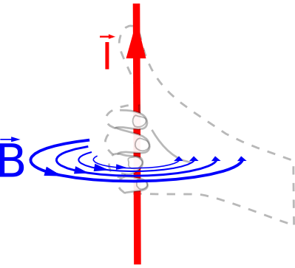
Face orientation rules
Based on the surface normal of each face
The order of the vertices implicitly defines the surface normal using the “right-hand thumb” rule
If the fingers curl along the order of the specification of the vertices, the outward thumb is the direction of the surface normal for the polygon.
Z
f
e
X
c
d
g
h
Y
a
b

Slide 28
Example of Optimized Solid : Box
Z
(4,4,2)
SDO_GEOMETRY (
3008 – 3-dimensional solid,
SRID,
NULL,
SDO_ELEM_INFO_ARRAY (
1 - starting offset,
1007 - solid element
3 - Axis-aligned box,
),
SDO_ORDINATE_ARRAY(
2,2,0, - first endpoint
4,4,2 - second endpoint
)
)
X
Y
(2,2,0)

Slide 29
Example of Solid with Hole
SDO_GEOMETRY (
3008 – 3-dimensional solid,
SRID,
NULL,
SDO_ELEM_INFO_ARRAY (
1, 1007, 1 - solid element
1, 1006, 6 - 1 exterior surface (formed
by 6 simple surfaces)
1, 1003, 1 – 6 simple surfaces
…
n, 2006, 6 - 1 interior surface
n, 1003, 1 – 6 simple surfaces
…
),
SDO_ORDINATE_ARRAY(
ordinate specification for:
-- each face of exterior surface (abdc,..),
-- each face of interior surface
(aHcHdHbH,…)
)
)
Z
f
e
X
c
d
g
h
Y
a
b
Hole:
(aH,bH,…hH)

Slide 30
Example: Building with Atrium Modeled as a composite solid
Y
Model as a composite solid formed from four simple solids:
A (north wing)
D (south wing)
B (west wing)
C (east wing)
A
B
C
X
D
Z

Slide 31
Example: Building with Atrium Modeled as a composite solid
SDO_GEOMETRY (
3008 – 3-dimensional solid,
SRID,
NULL,
SDO_ELEM_INFO_ARRAY (
1, 1008, 4 - composite solid (formed by 4
simple solids)
1, 1007, 1 - First solid
1, 1006, 6 - Cmp surf (6 simple surfaces)
1, 1003, 1 - 6 simple surfaces
…
n, 1007, 1 – last solid
n, 1006, 6 - Cmp surf (6 simple surfaces)
n, 1003, 1 – 6 simple surfaces
…
),
SDO_ORDINATE_ARRAY(
ordinate specification for each face of
each solid
)
)
A
B
C
X
D
Z

Slide 32
Example: Building with Atrium Modeled as a simple solid
Z
Can also model as a simple solid with a single composite surface.
Cannot represent top and bottom faces as polygons with holes.
Represent it as a simple solid with multiple faces:
Four top faces: a, b, c, d
Four side faces: e (front), f (right), g (back) and h (left)
Four bottom faces: i, j, k, l
Could also represent top and bottom surfaces as (ab) and (cd) or (abc) and (d)
a
b
c
X
d
f
Y
Z
e
ab
cd
X
f
Y
e

Slide 33
Example: Building with Atrium Modeled as a simple solid
Z
SDO_GEOMETRY (
3008 – 3-dimensional solid,
SRID,
NULL,
SDO_ELEM_INFO_ARRAY (
1, 1007, 1 - solid element
1, 1006,16 - 1 exterior surface (formed
by 16 simple surfaces)
1, 1003, 1 – 1st simple surface
…
n, 1003, 1 – last simple surface
),
SDO_ORDINATE_ARRAY(
ordinate specification for each face
(a, b, c, d)
(e, f, g, h)
…
)
)
a
b
c
X
d
f
Y
e

Slide 34
Validating 3D structures
Specific 3D rules applied
Arcs are not allowed
Lines: points with same X and Y but different Z are no longer considered as duplicates
Simple Surfaces: must be planar
Composite surfaces: simple surfaces must connect and be in different planes
Surfaces in solids must be correctly oriented
Different rules than 2D polygons
Surfaces cannot intersect
A hole in a solid must not touch any of the other surfaces

Slide 35
Validating 3D structures
VALIDATE_GEOMETRY_WITH_CONTEXT
RETURNS VARCHAR2
Argument Name Type
--------------- --------------
THEGEOMETRY SDO_GEOMETRY
TOLERANCE NUMBER
CONDITIONAL VARCHAR2
FLAG10G VARCHAR2
CONDITIONAL
Applies to composite surfaces (or solids)
Applies to adjacent faces in the same plane
When TRUE (the default) then this case is not allowed
When FALSE, this case is accepted
FLAG10G
Applies to 3D points, lines and polygons
When TRUE, validation is done on 2D rules (Z are ignored)
When FALSE (the default) validation is one on 3D rules
ORA-54516: adjacent outer rings of composite surface cannot be on same plane

Slide 36
Summary of 3D GTYPES
Object Type | GTYPE | Content
Point | 3001 | One 3D point
Line | 3002 | One 3D line
Surface | 3003 | One 3D surface (simple or composite)
Solid | 3008 | One 3D solid (simple or composite)
Multi Point | 3005 | Several points
Multi Line | 3006 | Several lines
Multi Surface | 3007 | Several surfaces
Multi Solid | 3009 | Several solids
Collection | 3004 | Any combination of 3D objects

Slide 37
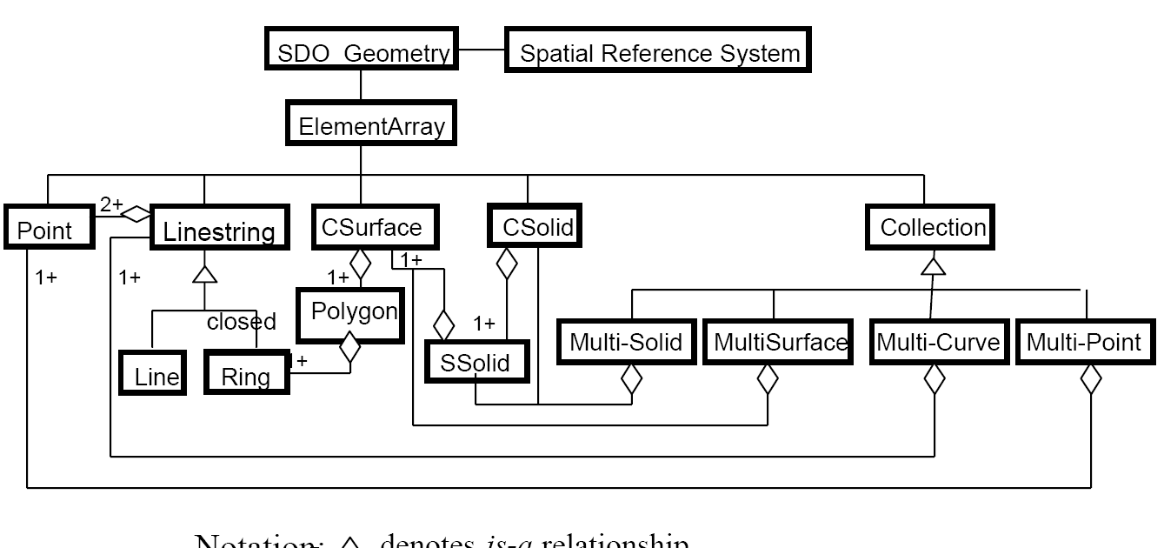
Spatial 3D Data Model
Hierarchical Decomposition
Multi Solid
Composite Solid
Simple Solid
Composite Surface
Face
Ring
Line
Point

Slide 38
<Insert Picture Here>
Operations on 3D Data

Slide 39
Operations on 3D Data
Spatial indexing in 3D
3D Rtrees
Spatial queries
SDO_FILTER
SDO_ANYINTERACT, SDO_INSIDE, SDO_CONTAINS
SDO_WITHIN_DISTANCE
SDO_NN
Measurements
Distance
Length
Area
Volume
Generate 3D shapes
Convert 2D polygons to 3D solids (by extrusion)
Publish
Extract 3D objects to KML and GML
Load
Load 3D objects from GML
Process
Extract components of a 3D geometry.
Solids, composite surfaces in each solid, simple surfaces, etc
Validate
Verify the validity of a 3D object

Slide 40
From 2D to 3D: Extrusion
Transform 2D polygons (building footprints) to 3D solids
Use the SDO_UTIL.EXTRUDE() function
Pass the 2D polygon as input
Pass the height of the solid
Pass the ground height
The result is a 3D solid
The function attempts to use the 3D SRID that corresponds to the input 2D SRID
Sets it to NULL if it finds no correspondance

Slide 41
Extrusion Syntax
GEOMETRY:
2D polygon to extrude
Must be a polygon without arcs but can have holes
GRDHEIGHT:
Ground height for each vertex of the polygon
Pass just one value if all vertices share the same ground height
HEIGHT:
Height for each vertex of the polygon
Pass just one value if all vertices share the same height
TOL:
Tolerance to use
OPTIONAL3DSRID:
Three-dimensional coordinate system (SRID) to be assigned to the returned geometry. If you do not specify this parameter, Spatial automatically assigns a three-dimensional SRID value based on the SRID value of the input geometry.
FUNCTION EXTRUDE
RETURNS SDO_GEOMETRY
Argument Name Type
--------------- ----------------
GEOMETRY SDO_GEOMETRY
GRDHEIGHT SDO_NUMBER_ARRAY
HEIGHT SDO_NUMBER_ARRAY
TOL NUMBER
OPTIONAL3DSRID NUMBER
Height
Ground height

Slide 42
Extrusion example
select sdo_util.extrude (
sdo_geometry(2003, null, null,
sdo_elem_info_array (1,1003,3),
sdo_ordinate_array (2,2, 4,4)
),
sdo_number_array(0),
sdo_number_array(2),
0.05
)
from dual;
X
Y
(2,2)
(4,4)
SDO_GEOMETRY (
3008, NULL, NULL,
SDO_ELEM_INFO_ARRAY(
1, 1007, 1, -- One simple solid
1, 1006, 6, -- One composite surface (6 faces)
1, 1003, 1, -- face 1
16, 1003, 1, -- face 2
31, 1003, 1, -- face 3
46, 1003, 1, -- face 4
61, 1003, 1, -- face 5
76, 1003, 1 -- face 6
),
SDO_ORDINATE_ARRAY(
2,4,0, 4,4,0, 4,2,0, 2,2,0, 2,4,0,
2,4,2, 2,2,2, 4,2,2, 4,4,2, 2,4,2,
2,4,0, 2,2,0, 2,2,2, 2,4,2, 2,4,0,
2,2,0, 4,2,0, 4,2,2, 2,2,2, 2,2,0,
4,2,0, 4,4,0, 4,4,2, 4,2,2, 4,2,0,
4,4,0, 2,4,0, 2,4,2, 4,4,2, 4,4,0
)
)
Z
X
Y

Slide 43
Extrusion example
select sdo_util.extrude (
sdo_geometry(2003, null, null,
sdo_elem_info_array (1,1003,3, 5,2003,3),
sdo_ordinate_array (2,2, 5,5, 3,3, 4,4)
),
sdo_number_array(0),
sdo_number_array(2),
0.05
)
from dual;
X
Y
SDO_GEOMETRY(
3008, NULL, NULL,
SDO_ELEM_INFO_ARRAY(
1, 1008, 2, -- Composite solid (formed by 2 solids)
1, 1007, 1, -- First solid
1, 1006, 11, -- Composite surface (11 faces)
1, 1003, 1,
31, 1003, 1,
61, 1003, 1,
76, 1003, 1,
91, 1003, 1,
106, 1003, 1,
121, 1003, 1,
136, 1003, 1,
151, 1003, 1,
166, 1003, 1,
181, 1003, 1,
196, 1007, 1, -- Second solid
196, 1006, 7, -- Composite surface (7 faces)
196, 1003, 1,
214, 1003, 1,
232, 1003, 1,
247, 1003, 1,
262, 1003, 1,
277, 1003, 1,
292, 1003, 1
),
SDO_ORDINATE_ARRAY (
4,2,0, 4,3,0, 4,4,0, 3,4,0, 3,3,0, 2,3,0, 2,5,0, 5,5,0, 5,2,0, 4,2,0,
4,2,2, 5,2,2, 5,5,2, 2,5,2, 2,3,2, 3,3,2, 3,4,2, 4,4,2, 4,3,2, 4,2,2,
…
3,3,0, 3,3,2, 4,3,2, 4,3,0, 3,3,0, 2,3,0, 2,3,2, 3,3,2, 3,3,0
)
)
Z
X
Y

Slide 44
Decomposing a 3D object: EXTRACT3D
FUNCTION EXTRACT3D
RETURNS SDO_GEOMETRY
Argument Name Type
--------------- ----------------
GEOMETRY SDO_GEOMETRY
LABEL VARCHAR2
GEOMETRY:
3D object to extract from
LABEL:
Specifies the component to extract.
A string of up to 7 comma-separated numbers
Each component of a 3D object has a unique label
Multi Solid
Composite Solid
Simple Solid
Composite Surface
Face
Ring
Edge
Point

Slide 45
Element Labels
Multi Solid
Composite Solid
Simple Solid
Composite Surface
Face
Ring
Edge
Point
Labels are strings of up to 7 comma-separated numbers
Each number identifies a component at a level of decomposition
P, E, R, F, S, V, M
M | Number of a solid in a multi-solid.
V | Number of a solid in a composite solid
S | Number of a composite surface in a simple solid
F | Number of a face in a composite surface
R | Number of a ring in a face
E | Number of a edge (line) in a ring
P | Number of point in an edge

Slide 46
Examples of Labels
Simple Solid
Gtype is 3008. Etype is 1007 (solid) followed by 1006 (composite surface) and 6x1003 (faces)
Composite surface of solid A: ‘0,0,0,0,1’
Faces of solid B: ‘0,0,0,1,1,’ to ‘0,0,0,6,1’
A
Composite Solid
A
Gtype is 3008. Etype is 1008 (composite solid) followed by 4x1007 (solids)
Solid A: ‘0,0,0,0,0,1’
Solid B: ‘0,0,0,0,0,2’
Composite surface of solid B: ‘0,0,0,0,1,2’
Faces of solid B: ‘0,0,0,1,1,2’ to ‘0,0,0,6,1,2’
B
C
D

Slide 47
Examples of Labels
Multi-Solid
Gtype is 3009. Etype is 1007 with 1006, then another 1007
Solid A: ‘0,0,0,0,0,0,1’
Solid B: ‘0,0,0,0,0,0,2’
Composite surface of solid B: ‘0,0,0,0,1,1,2’
Faces of solid B: ‘0,0,0,1,1,1,2’ to ‘0,0,0,6,1,1,2’
A
B
Composite Surface
Gtype is 3003. Etype is 1006 followed by 2x1003
Face A: ‘0,0,0,1’
Face B: ‘0,0,0,2’
A
B

Slide 48
<Insert Picture Here>
Publishing and Viewing
CityGML, KML

Slide 49
Convert to KML
Use the SDO_UTIL.TO_KMLGEOMETRY() function
Must use 11.1.0.7 or later !
select sdo_util.to_kmlgeometry(
sdo_util.extrude (
sdo_geometry(2003, null, null,
sdo_elem_info_array (1,1003,3, 5,2003,3),
sdo_ordinate_array (2,2, 5,5, 3,3, 4,4)
),
sdo_number_array(0),
sdo_number_array(2),
0.05
)
)
from dual;

Slide 50
Raw KML output
<MultiGeometry>
<Polygon>
<extrude>0</extrude><tessellate>0</tessellate><altitudeMode>relativeToGround</altitudeMode>
<outerBoundaryIs>
<LinearRing>
<coordinates>
4.0,2.0,0.0 4.0,3.0,0.0 4.0,4.0,0.0 3.0,4.0,0.0 3.0,3.0,0.0 2.0,3.0,0.0 2.0,5.0,0.0
5.0,5.0,0.0 5.0,2.0,0.0 4.0,2.0,0.0
</coordinates>
</LinearRing>
</outerBoundaryIs>
</Polygon>
<Polygon>
<extrude>0</extrude><tessellate>0</tessellate><altitudeMode>relativeToGround</altitudeMode>
<outerBoundaryIs>
<LinearRing>
<coordinates>
4.0,2.0,2.0 5.0,2.0,2.0 5.0,5.0,2.0 2.0,5.0,2.0 2.0,3.0,2.0 3.0,3.0,2.0 3.0,4.0,2.0
4.0,4.0,2.0 4.0,3.0,2.0 4.0,2.0,2.0
</coordinates>
</LinearRing>
</outerBoundaryIs>
</Polygon>
...
</MultiGeometry>

Slide 51
Generate KML documents
Use the XML facilities of the Oracle database
Then publish to XDB repository
Must convert to WGS84 (4327) if your data is projected
SELECT xmlelement ( "kml",
xmlattributes ('http://www.opengis.net/kml/2.2' as "xmlns"),
xmlelement ("Document",
xmlagg (
xmlelement ("Placemark",
xmlelement ("name", 'Building '|| gmlid),
xmltype (
sdo_util.to_kmlgeometry (sdo_cs.transform(geom,4327))
)
)
)
)
)
FROM buildings_ext;

Slide 52
Enable Access to XDB repository
Access to XDB repository is disabled by default
HTTP and FTP ports set to “0”
Check the current XDB port settings
Set HTTP and FTP Ports for XDB to standard ports
Create a folder for the KML files
select dbms_xdb.gethttpport as "HTTP-Port", dbms_xdb.getftpport as "FTP-Port"
from dual;
exec dbms_xdb.setHTTPPort(8090);
exec dbms_xdb.setFTPPort(21);
declare
result boolean;
begin
result := dbms_xdb.createFolder('/public/Buildings');
end;
/

Slide 53
Publish KML in the XDB Repository
declare
result boolean;
kmldoc xmltype;
begin
SELECT xmlelement ( "kml",
xmlattributes ('http://www.opengis.net/kml/2.2' as "xmlns"),
xmlelement ("Document",
xmlelement ("Style",
xmlattributes('BuildingStyle' as "id"),
xmlelement ("LineStyle", xmlelement ("width",'1'),xmlelement ("color“,'ff0000ff')),
xmlelement ("PolyStyle", xmlelement ("color", '7d0000ff'))
),
xmlagg (
xmlelement ("Placemark",
xmlelement ("name", 'Building '|| gmlid),
xmlelement ("styleUrl", '#BuildingStyle'),
xmltype (
sdo_util.to_kmlgeometry (snap_to_ground (sdo_cs.transform(geom,4327),0))
)
)
)
)
)
INTO kmldoc
FROM buildings_ext;
result := dbms_xdb.createResource ('/public/Buildings/buildings_ext.kml', kmldoc);
end;
/
Style definition
Use the style
Fix Z values
Transform to WGS84

Slide 54
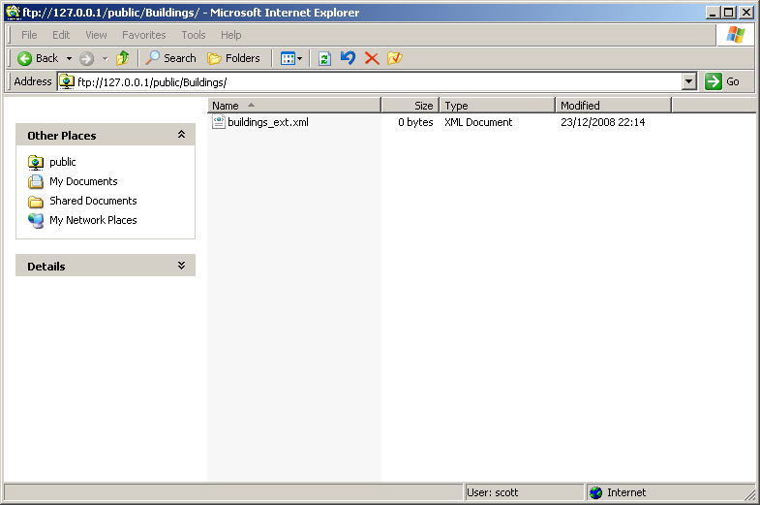
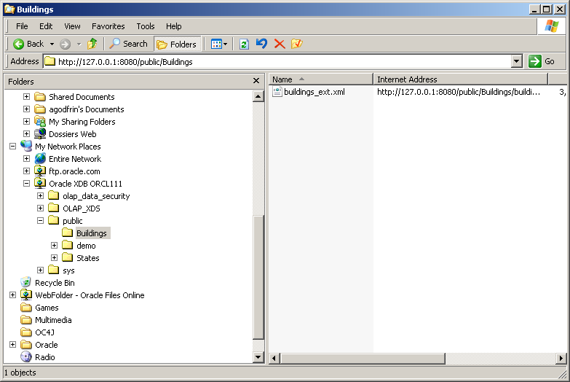
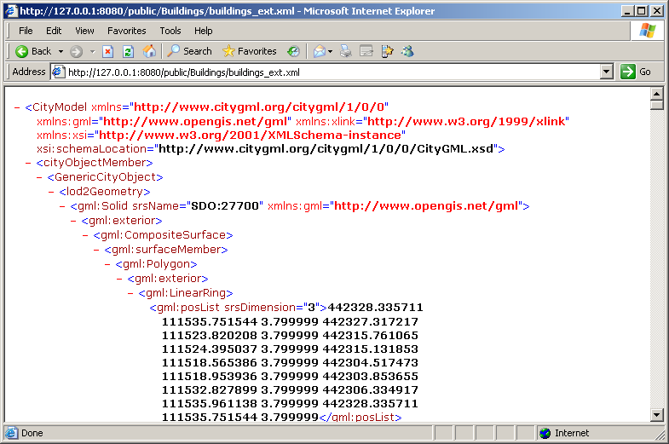
Access the KML files
FTP
WebDAV
HTTP

Slide 55
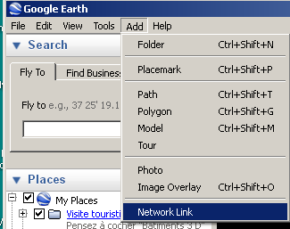
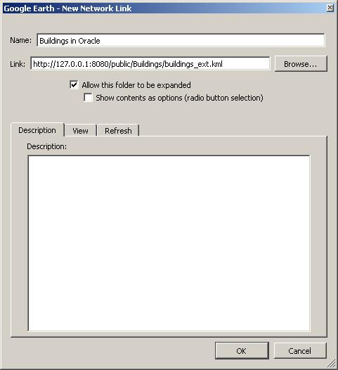
View in Google Earth
Define a network link to the kml file
Specify URL to the KML document in the Oracle XDB repository

Slide 56
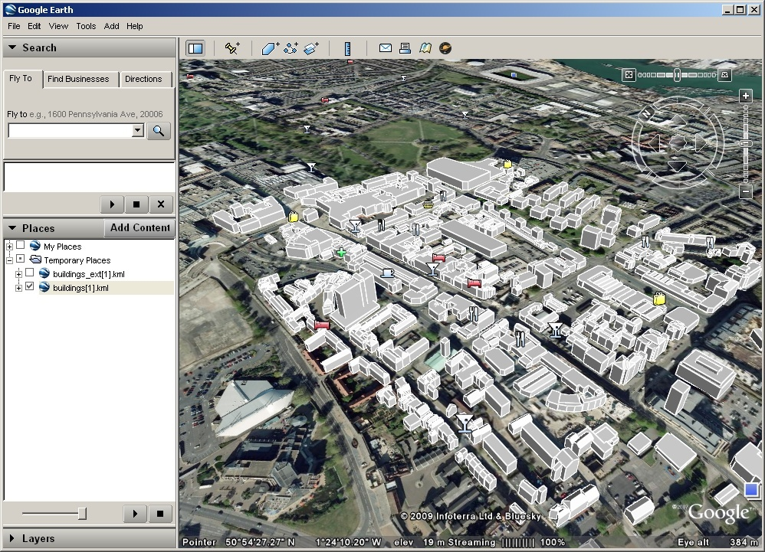
View in Google Earth

Slide 57
Convert to GML
Use the SDO_UTIL.TO_GML311GEOMETRY() function
select sdo_util.to_gml311geometry(
sdo_util.extrude (
sdo_geometry(2003, null, null,
sdo_elem_info_array (1,1003,3, 5,2003,3),
sdo_ordinate_array (2,2, 5,5, 3,3, 4,4)
),
sdo_number_array(0),
sdo_number_array(2),
0.05
)
)
from dual;

Slide 58
Raw GML output
<gml:CompositeSolid srsName="SDO:" xmlns:gml="http://www.opengis.net/gml">
<gml:solidMember>
<gml:Solid>
<gml:exterior>
<gml:CompositeSurface>
<gml:surfaceMember>
<gml:Polygon>
<gml:exterior>
<gml:LinearRing>
<gml:posList srsDimension="3">
4.0 2.0 0.0 ... 4.0 2.0 0.0
</gml:posList>
</gml:LinearRing>
</gml:exterior>
</gml:Polygon>
</gml:surfaceMember>
<gml:surfaceMember><gml:Polygon> ... </gml:Polygon></gml:surfaceMember>
...
<gml:surfaceMember><gml:Polygon> ... </gml:Polygon></gml:surfaceMember>
</gml:CompositeSurface>
</gml:exterior>
</gml:Solid>
</gml:solidMember>
<gml:solidMember><gml:Solid> ... </gml:Solid></gml:solidMember>
</gml:CompositeSolid>

Slide 59
Convert to CityGML
Use the XML facilities of the Oracle database
Then publish to XDB repository
SELECT xmlelement(
"CityModel",
xmlattributes(
'http://www.citygml.org/citygml/1/0/0' as "xmlns",
'http://www.opengis.net/gml' as "xmlns:gml",
'http://www.w3.org/1999/xlink' as "xmlns:xlink",
'http://www.w3.org/2001/XMLSchema-instance' as "xmlns:xsi“,
'http://www.citygml.org/citygml/1/0/0/CityGML.xsd' as "xsi:schemaLocation"
),
xmlagg (
xmlelement ("cityObjectMember",
xmlelement("GenericCityObject",
xmltype ( sdo_util.to_gml311geometry(geom) ) as "lod1Geometry"
)
)
)
)
as CityGML
FROM buildings_ext;

Slide 60
Publish GML in the XDB Repository
declare
result boolean;
gmldoc xmltype;
begin
SELECT xmlelement( "CityModel",
xmlattributes(
'http://www.citygml.org/citygml/1/0/0' as "xmlns",
'http://www.opengis.net/gml' as "xmlns:gml",
'http://www.w3.org/1999/xlink' as "xmlns:xlink",
'http://www.w3.org/2001/XMLSchema-instance' as "xmlns:xsi",
'http://www.citygml.org/citygml/1/0/0/CityGML.xsd' as "xsi:schemaLocation"
),
xmlagg (
xmlelement ("cityObjectMember",
xmlelement("GenericCityObject",
xmltype ( sdo_util.to_gml311geometry(geom) ) as "lod1Geometry"
)
)
)
)
INTO gmldoc
FROM buildings_ext;
result := dbms_xdb.createResource ('/public/Buildings/buildings_ext.xml', gmldoc);
end;
/

Slide 61
Access the XML files
FTP
WebDAV
HTTP

Slide 62
<Insert Picture Here>
Loading 3D data

Slide 63
Loading CityGML
Use the Java example program CGMLToSDO.java
Provided in $ORACLE_HOME/md/demo/CityGML/examples
Parses a CityGML file
Loads the objects into a table
set CLASSPATH=.;%ORACLE_HOME%/jdbc/lib/ojdbc5.jar; %ORACLE_HOME%/lib/xmlparserv2.jar;%ORACLE_HOME%/md/jlib/sdoapi.jar;%ORACLE_HOME%/md/jlib/sdoutl.jar
java SdoLoadCityGML -host 127.0.0.1 -port 1521 -sid orcl111 -user scott -password tiger -file CityGML_British_Ordnance_Survey.xml -table buildings -geomcol geom -featurecol feature -idcol building_id -srid 7405

Slide 64
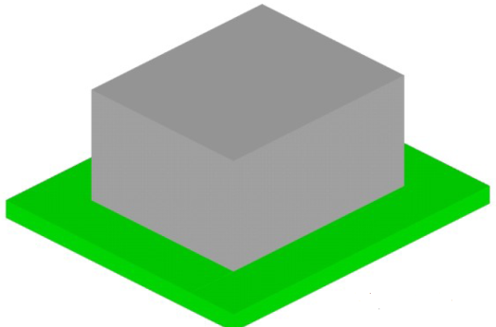
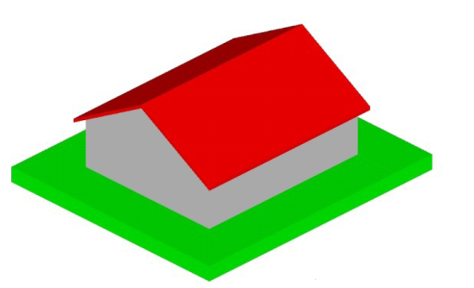
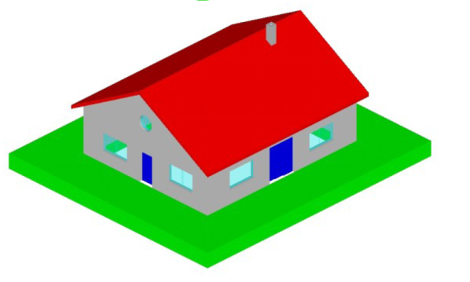
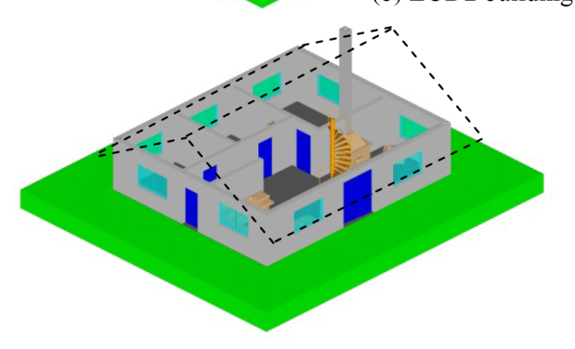
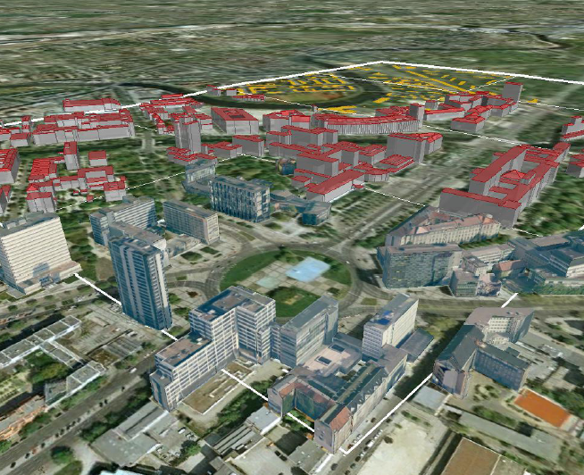


Data Models for City Landscapes
LOD1 Building
Blocks without roof structures
LOD2 Building
Full roof structures, possibly with textures
LOD3 Building
Detailed architecture
LOD4 Building
Interior structures
Structures at multiple levels of detail
Textures and facades
Orthophotos
Versioning
http://www.3dcitydb.net/
Illustrations courtesy of Technical University Berlin - Institute for Geodesy and Geoinformation Science

Slide 65
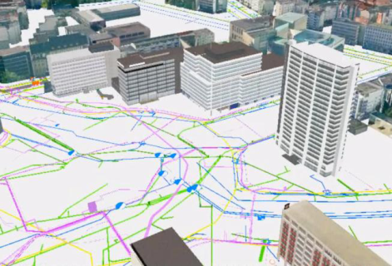
Semantic City Models
More than just visualization of reality
Geometries
Shape, location, topology
3D structures (solids, faces, …)
Appearance
Textures, levels of detail
Semantics
Meaning and function of the objects
Also part or objects
Queries combine geometry and semantics
Thematic display considering semantics
Multi-criteria analysis
Illustrations courtesy of Technical University Berlin - Institute for Geodesy and Geoinformation Science

Slide 66
<Insert Picture Here>
Querying 3D Data

Slide 67
Populate 3D metadata
SQL> INSERT INTO USER_SDO_GEOM_METADATA
2> (TABLE_NAME, COLUMN_NAME, DIMINFO, SRID)
3> VALUES (
4> 'BUILDINGS',
5> 'GEOM',
6> SDO_DIM_ARRAY (
7> SDO_DIM_ELEMENT ('Easting', 0, 1000000, 0.05),
8> SDO_DIM_ELEMENT ('Northing', 0, 1000000, 0.05),
9> SDO_DIM_ELEMENT ('Elevation', 0, 1000, 0.05)
10> ),
11> 27700
12> );

Slide 68
Creating a 3D index
Must specify explicitly
If not specified, you get a 2D index
The metadata must still be 3D!
SQL> CREATE INDEX buildings_sx ON buildings (geom)
2> INDEXTYPE IS MDSYS.SPATIAL_INDEX
3> PARAMETERS ('sdo_indx_dims=3');
SQL> CREATE INDEX buildings_sx ON buildings (geom)
2> INDEXTYPE IS MDSYS.SPATIAL_INDEX;

Slide 69
Some 3D queries
Find the building interacting with a 3D point
SELECT building_id, (height - ground_height) height
FROM buildings_ext
WHERE SDO_ANYINTERACT (
geom,
SDO_GEOMETRY (
3001, 7405,
SDO_POINT_TYPE (442249, 111480, 8),
NULL,NULL
)
) = 'TRUE';

Slide 70
Some 3D queries
Find the building interacting with a 3D point
Point is in WGS84 (GPS) coordinates
SELECT building_id, (height - ground_height) height
FROM buildings_ext
WHERE SDO_ANYINTERACT (
geom,
SDO_GEOMETRY (
3001, 4327,
SDO_POINT_TYPE (-1.400562, 50.9012567, 55.0693992),
NULL,NULL
)
) = 'TRUE';

Slide 71
Some 3D queries
Find all buildings less than 50 meters from one specific building
SELECT b1.building_id,
SDO_GEOM.SDO_DISTANCE (
b1.geom, b2.geom, 0.05) distance,
(b1.height - b1.ground_height) height
FROM buildings_ext b1,
buildings_ext b2
WHERE SDO_WITHIN_DISTANCE (
b1.geom, b2.geom, 'distance=50 unit=m'
) = 'TRUE'
AND b2.building_id = 42
ORDER BY distance;

Slide 72
Some 3D queries
Get the building closest to one selected building, and that is over 2 meters taller
SELECT b1.building_id,
(b1.height - b1.ground_height) height
FROM buildings_ext b1,
buildings_ext b2
WHERE SDO_NN (b1.geom, b2.geom) = 'TRUE'
AND b2.building_id = 42
AND (b1.height-b1.ground_height) –
(b2.height-b2.ground_height) > 2
AND ROWNUM <= 1;

Slide 73
Combining 2D and 3D
Query 3D data using a 2D window
Example:
Find all (3D) pipeline sections that cross a (2D) land parcel
Query 2D data using a 3D window
Example:
Find all (2D) land parcels on the path of a (3D) pipeline section

Slide 74
Combining 2D and 3D Summary of Capabilities
Data | Index | Window
 |  | 2D | 3D
2D | 2D | 2D Query | 2D Query (Z are ignored)
3D | 2D | 2D Query (Z are ignored)
 | 3D | 3D Query with Z forced to 0 | 3D Query

Slide 75
Java Interface
Class J3D_Geometry
Subtype of JGeometry
Some methods :
Validate (tolerance): Returns true or false
Distance (J3D_geometry): Returns distance
Anyinteract (J3D_Geometry): Returns true or false
Length(): returns the length of a line geometry
Area(): returns area for a surface geometry
Volume(): returns volume of a solid geometry
Classe ElementExtractor
Extract and iterate on all components of a J3D_Geometry
Solids, composite surfaces in each solid, simple surfaces, etc.

Slide 76

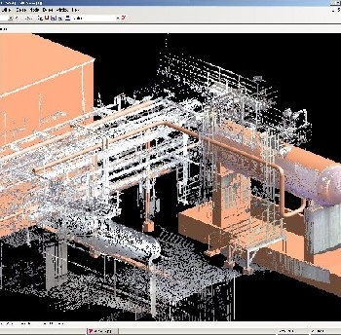
<Insert Picture Here>
Point Clouds

Slide 77

What is LiDAR Data ?
Laser Imaging Detection and Ranging
Collection performed by:
Airplanes, helicopters or drones
Ground vehicles
Underwater vehicles
Fixed stations
Sensors collect millions of 3D points per second, along with attributes
Results are scenes formed of billions of points (“point clouds”)

Slide 78
Point Cloud Challenges
Data Volumes
increasing densities with technology – Billions of points
Multi-return 150 KHz * 4 = 600k/sec
Full-waveform 250 KHz * 2048 =512,000,000/sec
Storage
Where do I put all this data ?
Archive? Security ? Compress?
Optimal format for analysis? LAS, LAZ, CSV, Proprietary
Analysis
Derivative product generation (TINs, Contours, DEMs)
Correlate with other data (vector, raster, networks, addresses …)

Slide 79
Storage Model (1): using the SDO_PC type
Separates logical from physical structures
Logical structures
Tables containing an SDO_PC column
Contains generic attributes and footprint
Also contains a pointer to a PC block table
Physical structures
“Block tables”
Contain point cloud blocks
Can be very large
Structure defined in SDO_PC_BLK object type

Slide 80
Storage Model
Logical structures
Contains point cloud metadata and footprint
Also contains a pointers to one or more block tables
Physical structures
Point cloud block tables
Contain the points
Can be very large
Could be partitioned
Add new tables as necessary
pc 1
pc 1 blocks
pc 2
pc 2 blocks
pc 3
pc 3 blocks
pc 4
pc 4 blocks
pc 5
pc 5 blocks
pc 6
pc 6 blocks

Slide 81
Storage Model
PC blocks table 1
PC table
pc 1 blocks
pc 1
pc 2 blocks
pc 3 blocks
pc 2
pc 3
pc 4
PC blocks table 2
pc 5
pc 4 blocks
pc 6
pc 5 blocks
pc 6 blocks

Slide 82
Storage Model
PC table 1
pc 1
PC blocks table
pc 2
pc 1 blocks
pc 3
pc 2 blocks
pc 3 blocks
PC table 2
pc 4 blocks
pc 5 blocks
pc 4
pc 6 blocks
pc 5
pc 6

Slide 83
Package SDO_PC_PKG
Initialization of a « point cloud »
sdo_pc_pkg.init()
Loading a point cloud from a set of point objects
sdo_pc_pkg.create_pc()
Extracting points in a spatial window
sdo_pc_pkg.clip_pc()
Converting to SDO_GEOMETRY
sdo_pc_pkg. to_geometry()

Slide 84
Point Clouds Workflow using SDO_PC
LiDAR Files
LiDAR Files
Flat Files
Point loader
Load flat ASCII files into point tables …
Point tables
… then build the point cloud from the point tables
Build from point tables
Query and Clip
Convert to Geometries
Point Cloud tables
Direct load from LAS files
Generate Elevation Contour Lines
Flat files
Flat files
LiDAR files
LiDAR loader

Slide 85
Loading Point Clouds in SDO_PC
Input: Files in ASPRS LAS binary format (« LAS files »)
Option 1: Direct Loading
Use commercial tools (FME etc)
Use open source libLAS tools and libraries (« las2oci »)
Option 2: Loading via text formats
Convert LAS files to text flat files (« las2txt »)
Load text files into a simple point table (sql*loader)
Create point cloud from the point table

Slide 86
1. Creating Point Cloud Tables
Use the SDO_PC type
Can have any number of PC tables
Include any combination of attributes
Scenes can be searched on any attribute
Also the spatial extent of the scene
CREATE TABLE LIDAR_SCENES(
ID NUMBER PRIMARY KEY,
COLLECTION_TS TIMESTAMP,
DESCRIPTION CLOB,
... (any number of attributes) ...
POINT_CLOUD SDO_PC
);

Slide 87
The SDO_PC type
PC_EXTENT is the footprint of the point cloud
Needs a spatial index to support spatial searching
BASE_TABLE VARCHAR2(70)
BASE_TABLE_COL VARCHAR2(1024)
PC_ID NUMBER
BLK_TABLE VARCHAR2(70)
PTN_PARAMS VARCHAR2(1024)
PC_EXTENT MDSYS.SDO_GEOMETRY
PC_TOL NUMBER
PC_TOT_DIMENSIONS NUMBER
PC_DOMAIN MDSYS.SDO_ORGSCL_TYPE
PC_VAL_ATTR_TABLES MDSYS.SDO_STRING_ARRAY
PC_OTHER_ATTRS SYS.XMLTYPE
PC table and column
Block table and column

Slide 88
The SDO_PC type
Attribute | Explanation
BASE_TABLE | Name of the base table containing a column of type SDO_PC
BASE_TABLE_COL | Name of the column of type SDO_PC in the base table
PC_ID | ID number for the point cloud
BLK_TABLE | Name of the table that contains information about each block in the point cloud.
PTN_PARAMS | Parameters for partitioning the point cloud
PC_EXTENT | SDO_GEOMETRY object representing the spatial extent of the point cloud (the minimum bounding object enclosing all objects in the point cloud)
PC_TOL | Tolerance value for points in the point cloud.
PC_TOT_DIMENSIONS | Total number of dimensions in the point cloud. Includes spatial dimensions and any nonspatial dimensions, up to a maximum total of 9.
PC_DOMAINS | (Not currently used.)
PC_VAL_ATTR_TABLES | SDO_STRING_ARRAY object specifying the names of any value attribute tables for the point cloud
PC_OTHER_ATTRS | XMLTYPE object specifying any other attributes of the point cloud

Slide 89
2. Creating Point Cloud Block Tables
Using the SDO_PC_BLK type
Define a primary key on the object and block ids
Use SECUREFILE lobs (new structure in 11g)
Allows compression of the LOBs!
(also encryption and de-duplication)
CREATE TABLE PC_BLK_01 OF SDO_PC_BLK (
PRIMARY KEY (
OBJ_ID, BLK_ID
)
)
LOB(POINTS) STORE AS SECUREFILE
(COMPRESS HIGH NOCACHE NOLOGGING);

Slide 90
The SDO_PC_BLK type
Describes one block of points
Contains the unique identifier of the block
Scene id (OBJ_ID, same as PC_ID) and block id (BLK_ID)
OBJ_ID NUMBER
BLK_ID NUMBER
BLK_EXTENT MDSYS.SDO_GEOMETRY
BLK_DOMAIN MDSYS.SDO_ORGSCL_TYPE
PCBLK_MIN_RES NUMBER
PCBLK_MAX_RES NUMBER
NUM_POINTS NUMBER
NUM_UNSORTED_POINTS NUMBER
PT_SORT_DIM NUMBER
POINTS BLOB

Slide 91
The SDO_PC_BLK type
Attribute | Explanation
OBJ_ID | ID number of the point cloud object
BLK_ID | ID number of the block.
BLK_EXTENT | Spatial extent of the block.
BLK_DOMAIN | (Not currently used.)
PCBLK_MIN_RES | Minimum resolution level at which the block is visible in a query. The block is retrieved only if the query window intersects the spatial extent of the block and if the minimum - maximum resolution interval of the query. Usually, lower values mean farther from the view point, and higher values mean closer to the view point.
PCBLK_MAX_RES | Maximum resolution level at which the block is visible in a query.
NUM_POINTS | Total number of points in the POINTS BLOB
NUM_UNSORTED_POINTS | Number of unsorted points in the POINTS BLOB
PT_SORT_DIM | Number of the dimension (1 for the first dimension, 2 for the second dimension, etc) on which the points are sorted.
POINTS | BLOB containing the points.

Slide 92
PC BLOB Structure
The BLOB contains an array of points
Each point encoded as
d 64-bit floating point numbers (d = the dimensionality of the point)
One 32 bit integer representing the point number
One 32 bit integer representing the partition (= block) number
Future: compressed format
Storing coordinates as offsets from the origin of the block MBR
Using short integers

Slide 93


3. Loading using libLAS
Available from http://liblas.org/
For Windows, download and install pre-build binaries in the OSGeo4W package http://trac.osgeo.org/osgeo4w/
A packaging of a number of open source tools: libraries, desktop GIS (Quantum, Grass, …), servers (UMN Mapserver, …)
Main tools (see http://liblas.org/docs.html for details)
lasinfo = returns information about a LAS file
las2oci = loads a LAS file into Oracle
las2las = copy and transform a LAS file
las2txt = converts a LAS file to a text format
txt2las = the reverse
NOTES
liblas needs gdal 1.8 to be installed

Slide 94
Using las2oci
las2oci --verbose --input Serpent_Mound_Model_LAS_Data.las
--connection scott/tiger@orcl112
--base-table-name LIDAR_SCENES --cloud-column-name POINT_CLOUD
--block-table-name PC_BLK_01 --block-capacity 10000
--srid 32617
--input | Path to the input LAS file
--connection scott/tiger@orcl112 | Database connection
--base-table-name LIDAR_SCENES | Name of point cloud table
--cloud-column-name POINT_CLOUD | Name of point cloud column
--block-table-name PC_BLK_01 | Name of the block table
--block-capacity 10000 | Points per block
--srid 32617 | Coordinate system of the point cloud

Slide 95
Using las2oci
If the block table does not exist, it will be created automatically
Better to create it yourself beforehand
The point cloud table must contain a column called ID
Automatically numbered
Many parameters available
« las2oci --help» or see http://liblas.org/utilities/las2oci.html
Filter and transform input
Apply pre and post SQL
NOTE: las2oci loads only the X,Y,Z, Intensity and Time dimensions

Slide 96
4. Loading from text files
The input is a comma-separated-values (csv) file structure
You can create one from a las file using las2txt
Can choose the format of the output (precision, separator, content)
Can apply various filters and transformations
las2txt –i Serpent_Mound_Model_LAS_Data.las
-o Serpent_Mound_Model_LAS_Data.dat -v
289814.15,4320978.61,170.76
289814.64,4320978.84,170.76
289815.12,4320979.06,170.75
289815.60,4320979.28,170.74
...

Slide 97
Use all dimensions
Specify the dimensions to include
M specifies a point sequence number
Note that the SDO_PC type only allows 9 dimensions.
las2txt –input Serpent_Mound_Model_LAS_Data.las
--output Serpent_Mound_Model_LAS_Data.dat
--parse Mxyzirndecaup -v
0,289814.15,4320978.61,170.76,260,0,6,0,0,2,,,32760
1,289814.64,4320978.84,170.76,280,0,6,0,0,2,,,32760
2,289815.12,4320979.06,170.75,280,0,6,0,0,2,,,32760
3,289815.60,4320979.28,170.74,280,0,6,0,0,2,,,32760
...

Slide 98
Load the Text File into a Point Table
CREATE TABLE input_points (
rid VARCHAR2(40),
val_d1 NUMBER,
val_d2 NUMBER,
val_d3 NUMBER
)
Input table is a text file
Load using SQL*Loader
sqlldr scott/tiger
control=point_table.ctl
data=input_points.dat
direct=true
columnarrayrows=20000
streamsize=2560000
multithreading=true
LOAD DATA
TRUNCATE
INTO TABLE input_points
FIELDS TERMINATED BY ',' (
rid sequence,
val_d1,
val_d2,
val_d3
)
-73.999922, 40.000002, 74
-73.999921, 40.000002, 27
-73.999920, 40.000002, 76
-73.999919, 40.000002, 72
-73.999918, 40.000002, 91
-73.999917, 40.000002, 96

Slide 99
Initialize the Point Cloud
Define the structure and organization of the point cloud
Resolution, dimensions, extent
Block capacity
Specify the location of the blocks for each point cloud
Name of the point blocks table
The unique identifier of the point cloud is automatically generated.
INSERT INTO LIDAR_SCENES (ID, POINT_CLOUD)
VALUES (
101,
SDO_PC_PKG.INIT(
BASETABLE => 'LIDAR_SCENES',
BASECOL => 'POINT_CLOUD',
BLKTABLE => 'PC_BLK_01',
PTN_PARAMS => 'BLK_CAPACITY=10000',
PC_TOL => 0.05,
PC_TOT_DIMENSIONS => 3,
PC_EXTENT =>
SDO_GEOMETRY (2003, 32617, NULL,
SDO_ELEM_INFO_ARRAY (1,1003,3),
SDO_ORDINATE_ARRAY (
289021, 4320940, 290106, 4323640
)
)
)
);

Slide 100
Load the Point Cloud from the Point Table
Notes
This needs the CREATE VIEW right
Repeating the operation on the same point cloud object will APPEND the new data (not replace it!)
Load a point cloud from a flat table
Structure of the input table
DECLARE
PC SDO_PC;
BEGIN
SELECT POINT_CLOUD INTO PC
FROM LIDAR_SCENES WHERE SCENE_ID = 1;
SDO_PC_PKG.CREATE_PC (PC, 'INPUT_POINTS');
END;
/
RID VARCHAR2(40)
VAL_D1 NUMBER
VAL_D2 NUMBER
…
VAL_Dn NUMBER
Unique point identifier
Point coordinates

Slide 101
5. Create Spatial Indexes
Index on the scenes
INSERT INTO user_sdo_geom_metadata (
table_name, column_name, diminfo, srid)
VALUES (
'LIDAR_SCENES',
'POINT_CLOUD.PC_EXTENT',
sdo_dim_array(
sdo_dim_element('Easting', 200000, 300000, 0.05),
sdo_dim_element('Northing', 4300000, 4400000, 0.05)
),
32617
);
CREATE INDEX lidar_scenes_sx
ON lidar_scenes (point_cloud.pc_extent)
INDEXTYPE IS MDSYS.SPATIAL_INDEX;

Slide 102
Create Spatial Indexes
Index on the point cloud blocks
Note
SDO_PC_PKG.CREATE_PC () automatically creates this index
INSERT INTO user_sdo_geom_metadata (
table_name, column_name, diminfo, srid)
VALUES (
'PC_BLK_01',
'BLK_EXTENT',
sdo_dim_array(
sdo_dim_element('Easting', 200000, 300000, 0.05),
sdo_dim_element('Northing', 4300000, 4400000, 0.05)
),
32617
);
CREATE INDEX pc_blk_01_sx
ON pc_blk_01 (blk_extent)
INDEXTYPE IS MDSYS.SPATIAL_INDEX;

Slide 103
6. Processing Point Clouds
Select scenes using spatial operators
SDO_PC. PC_EXTENT has the extent of each scene
SDO_ANYINTERACT, SDO_NN, SDO_FILTER, …
Clip from a scene using a geometric window
Convert to regular geometries
Can also use spatial operators to search through point blocks
SDO_PC_BLK. BLK_EXTENT has the extent of each block

Slide 104
Processing Point Clouds
CLIP_PC
Clip Point Cloud
2D or 3D query window
Returns points for any block whose extent intersects the query window
Only points that intersect the query window are returned
Creates a set of PC blocks, can be stored or used in queries
TO_GEOMETRY
Converts the points from a PC block into a multi-point geometry.
Can be from a CLIP_PC operation

Slide 105
CLIP_PC: Clipping from a Point Cloud
DECLARE
clip_window SDO_GEOMETRY;
BEGIN
-- Get the clipping window
SELECT geom
INTO clip_window
FROM us_parks
WHERE name = 'Serpent Mound State Memorial';
-- Find the matching scenes
FOR s IN (
SELECT point_cloud
FROM lidar_scenes s
WHERE sdo_anyinteract(
s.point_cloud.pc_extent, clip_window) = 'TRUE'
)
LOOP
-- Clip out the desired subset from the scene
INSERT INTO clipped_lidar_scenes_blocks
SELECT * FROM TABLE (
sdo_pc_pkg.clip_pc (
INP => s.point_cloud,
IND_DIM_QRY => clip_window,
OTHER_DIM_QRY => null,
QRY_MIN_RES => null,
QRY_MAX_RES => null
)
);
END LOOP;
END;
Clip the points that intersect “Serpent Mound State Memorial Park”
Selects points from a point cloud that are within a spatial window.
Can also select points based on specific dimension values
Results in an array of point blocks

Slide 106
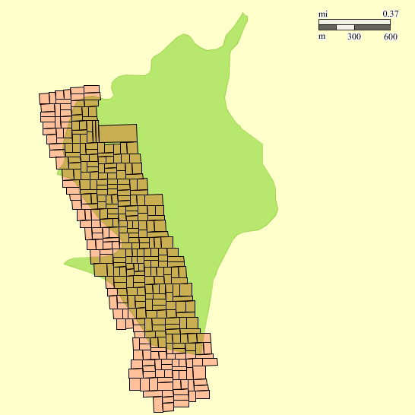
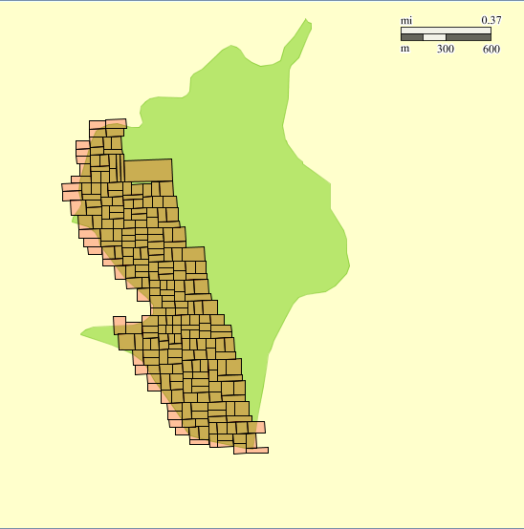
Clipping Result
Clip the points that intersect “Serpent Mound State Memorial Park”
Input
Result

Slide 107
Clipping from a Point Cloud
DECLARE
clip_window SDO_GEOMETRY;
BEGIN
-- Construct the clipping window
clip_window := sdo_geom.sdo_buffer (
SDO_GEOMETRY(2001, 4326,
SDO_POINT_TYPE(-83.430895, 39.0243455, NULL),
NULL, NULL),
200, 0.05, 'UNIT=METER'
);
-- Find the matching scenes
FOR s IN (
SELECT point_cloud
FROM lidar_scenes s
WHERE sdo_anyinteract(
s.point_cloud.pc_extent, clip_window) = 'TRUE'
)
LOOP
-- Clip out the desired subset from the scene
INSERT INTO clipped_lidar_scenes_blocks
SELECT * FROM TABLE (
sdo_pc_pkg.clip_pc (
INP => s.point_cloud,
IND_DIM_QRY => clip_window,
OTHER_DIM_QRY => null,
QRY_MIN_RES => null,
QRY_MAX_RES => null
)
);
END LOOP;
END;
Clip a 200 meter buffer around a point
The clipping window can be in any coordinate system
Will automatically be transformed to the coordinate system of the points

Slide 108
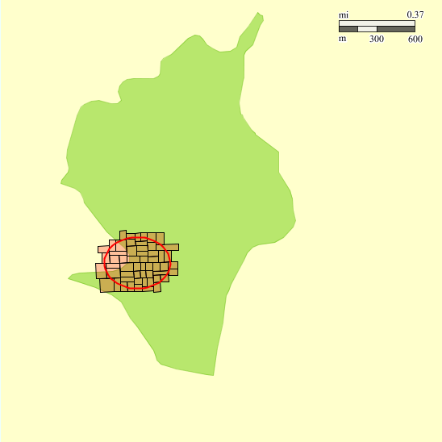
Clipping Result
Clip a 200 meter buffer around a point
Input
Result

Slide 109
TO_GEOMETRY: Convert to Geometries
Extracts the points from a point cloud block
Convert to a multi-point SDO_GEOMETRY object
Can optionally extract the identifiers of the points
NOTES:
Must specify the correct dimensionality for the points BLOB!
CREATE TABLE clipped_lidar_scenes_geom (
obj_id NUMBER,
blk_id NUMBER,
num_points NUMBER,
points SDO_GEOMETRY,
);
INSERT INTO clipped_lidar_scenes_geom
SELECT obj_id, blk_id, num_points,
sdo_pc_pkg.to_geometry (
points, -- LOB containing the points
num_points, -- # of points in the LOB
5, -- Dimensionality of the points
32617 -- SRID for the point cloud
)
FROM clipped_lidar_scenes_blocks;

Slide 110
TO_GEOMETRY result
The geometry has 5 dimensions!
Points are ordered by their ID
SDO_GEOMETRY( 5005, 32617, NULL,
SDO_ELEM_INFO_ARRAY(1, 1, 9985),
SDO_ORDINATE_ARRAY(
289293.07, 4323470.18, 180.28, 499919.445, 2,
289293.57, 4323470.25, 180.44, 499919.445, 2,
289331.77, 4323386.45, 202.53, 499921.132, 2,
289331.25, 4323386.37, 202.59, 499921.132, 2
)
)
X
Y
Z
Intensity
Time

Slide 111
TO_GEOMETRY result with point IDs
The geometry has 7 dimensions!
Points are ordered by their ID
SDO_GEOMETRY( 7005, 32617, NULL,
SDO_ELEM_INFO_ARRAY(1, 1, 9985),
SDO_ORDINATE_ARRAY(
289293.07, 4323470.18, 180.28, 499919.445, 2, 319, 946093,
289293.57, 4323470.25, 180.44, 499919.445, 2, 319, 946094,
289331.77, 4323386.45, 202.53, 499921.132, 2, 319, 1030212,
289331.25, 4323386.37, 202.59, 499921.132, 2, 319, 1030213
)
)
X
Y
Z
Intensity
Time
Point ID
Block ID

Slide 112
Viewing the Points
Must first convert the geometries to valid 3D points!
Use a custom function to remove the additional dimensions
Setup spatial metadata and index
UPDATE clipped_lidar_scenes_geom SET points = remove_attributes (points) ;
insert into user_sdo_geom_metadata (table_name, column_name, diminfo, srid)
values (
'CLIPPED_LIDAR_SCENES_GEOM', POINTS',
sdo_dim_array(
sdo_dim_element('Easting', 200000, 300000, 0.05),
sdo_dim_element('Northing', 4300000, 4400000, 0.05),
sdo_dim_element('Elevation', -10000, 10000, 0.05)
),
32617
);
CREATE INDEX clipped_lidar_scenes_geom ON clipped_lidar_scenes_geom (points)
indextype is MDSYS.SPATIAL_INDEX;

Slide 113
The REMOVE_ATTRIBUTES function
create or replace function remove_attributes (geom_in sdo_geometry, new_dim number := 3)
return sdo_geometry
is
geom_out sdo_geometry;
dimension number;
num_points number;
i number; j number; k number;
begin
dimension := geom_in.get_dims();
num_points := geom_in.sdo_ordinates.count / dimension;
geom_out := sdo_geometry (
new_dimension*1000+5, -- SDO_GTYPE: 2 or 3D multi-point (2005 or 3005)
geom_in.sdo_srid, -- SDO_SRID: same as input
null, -- SDO_POINT: not used
geom_in.sdo_elem_info, -- SDO_ELEM_INFO: same as input
sdo_ordinate_array() -- SDO_ORDINATES: empty
);
geom_out.sdo_ordinates.extend(new_dimension * num_points);
j := 0; k := 0;
for i in 1..num_points loop
geom_out.sdo_ordinates (j+1) := geom_in.sdo_ordinates (k+1); -- Copy X
geom_out.sdo_ordinates (j+2) := geom_in.sdo_ordinates (k+2); -- Copy Y
geom_out.sdo_ordinates (j+3) := geom_in.sdo_ordinates (k+3); -- Copy Z
j := j + new_dim; k := k + dimension;
end loop;
return geom_out;
end;
/
Copy points from old to new geometry, retaining only the first three dimensions (X, Y and Z)

Slide 114
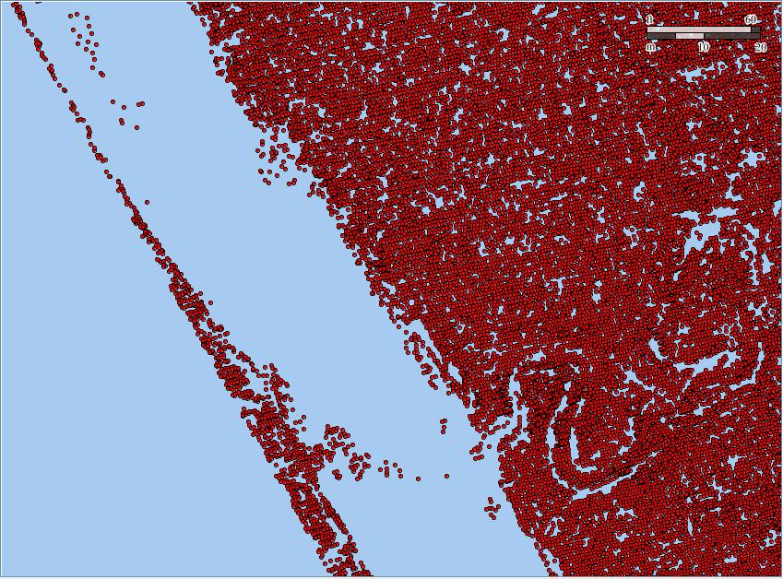
Viewing the Points

Slide 115
Storage Model (2): Simple Point Tables
CREATE TABLE points (
x NUMBER,
y NUMBER,
z NUMBER,
intensity NUMBER,
returnval NUMBER,
red NUMBER,
green NUMBER,
blue NUMBER
);
“Back to basics… a simple flat relational model
X, Y, Z and other attributes stored as ordinary columns
No indexes needed
Takes advantage of intelligent Exadata storage servers
HCC compression, for extremely high compression rates
Parallel Enabled Smart Scan for extreme performance, including spatial queries.

Slide 116
Point Clouds Workflow for Relational Type
LiDAR Files
LiDAR Files
LiDAR Files
Direct load from LAS files
Copy
Query and Clip
Convert to Geometries
Point tables
Generate Elevation Contour Lines
Copy
Direct load from flat ASCII files
Flat files
Flat files
Flat files

Slide 117
Loading: Simple and Direct
LiDAR Files
LiDAR Files
LiDAR Files
Define flat files and LAS files as external tables
Pre-processor extracts points from LAS files
Loading is a simple data copy from the external table to the point table
Copy
Point tables
CREATE TABLE points
NOLOGGING
COMPRESS FOR QUERY HIGH
PARALLEL 96
AS
SELECT x,y,z, intensity, returnval,
red, green, blue
FROM points_las_ext;
Copy
Flat files
Flat files
Flat files

Slide 118
External Table Definition for CSV input
CREATE TABLE points_csv_ext (
x NUMBER,
y NUMBER,
z NUMBER,
intensity NUMBER,
returnval NUMBER,
red NUMBER,
green NUMBER,
blue NUMBER
)
ORGANIZATION EXTERNAL (
TYPE ORACLE_LOADER
DEFAULT DIRECTORY las_data_dir
ACCESS PARAMETERS (
RECORDS DELIMITED BY NEWLINE
FIELDS TERMINATED BY ",")
LOCATION (
'lidar_data_01.dat',
'lidar_data_02.dat’
)
)
REJECT LIMIT UNLIMITED;
Any number of input files

Slide 119
External Table Definition for LAS input
CREATE TABLE points_las_ext (
x NUMBER,
y NUMBER,
z NUMBER,
intensity NUMBER,
returnval NUMBER,
red NUMBER,
green NUMBER,
blue NUMBER
)
ORGANIZATION EXTERNAL (
TYPE ORACLE_LOADER
DEFAULT DIRECTORY las_data_dir
ACCESS PARAMETERS (
PREPROCESSOR 'preprocessor.sh'
RECORDS DELIMITED BY NEWLINE
FIELDS TERMINATED BY ",")
LOCATION (
'lidar_data_01.las',
'lidar_data_02.las’
)
)
REJECT LIMIT UNLIMITED;
Filter for LAS data
Any number of input files

Slide 120


Point Cloud tools
libLAS (http://liblas.org/)
Conversion tools, including las2oci
LAStools (http://rapidlasso.com)
Maintained by Martin Isenburg, rapidlasso GmbH
Built on LASlib.
Rich set of processing tools: clip, merge, classify, grid, tile, …
Conversion tools: las to DEM, tin, shape, …
Simple viewer and simple gui
See http://liblas.org/lastools.html for details on the relationship between libLAS and LAStools

Slide 121

Point Cloud tools
PDAL (http://pointcloud.org/)
Point Data Abstraction Library, analogous to GDAL
Data transformation and data access
Abstract processing from storage
Version 1.0 released
http://www.laszip.org has pointers to many sources of public LiDAR data

Slide 122
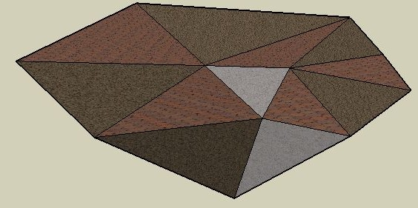
<Insert Picture Here>
Triangulated Irregular Networks (TINs)

Slide 123
Triangulated Irregular Networks (TINs)
Representation of surfaces / terrains
Contains a network of irregularly placed triangles
Each point (triangle node) has X, Y and Z coordinates
Node No | X | Y | Z
1 | 15.33 | 6.32 | 3.5
2 | 30.25 | 6.65 | 5.2
3 | 10.43 | 5.19 | 6.1
4 | 14.65 | 9.72 | 4.0
5 | 16.53 | 5.36 | 3.6
6 | 21.22 | 2.23 | 2.3
: | : | : | :
Triangle No | Node 1 | Node 2 | Node 3
1 | 5 | 6 | 3
2 | 3 | 6 | 5
3 | 1 | 5 | 6
: | : | : | :

Slide 124
Storage Model
Separates logical from physical structures
Logical structures
Tables containing an SDO_TIN column
Contains metadata and footprint
Also contains a pointer to a TIN block table
Physical structures
“Block tables”
Contain points and triangles
Can be very large
Structure defined in SDO_TIN_BLK object type

Slide 125
Storage Model
TIN table
TIN blocks table
tin 1
tin 1 blocks
tin 2
tin 2 blocks
tin 3
tin 3 blocks
tin 4
tin 4 blocks
tin 5
tin 5 blocks
tin 6
tin 6 blocks

Slide 126
Storage Model
TIN blocks table 1
TIN table
tin 1 blocks
tin 1
tin 2 blocks
tin 3 blocks
tin 2
tin 3
tin 4
TIN blocks table 2
tin 5
tin 4 blocks
tin 6
tin 5 blocks
tin 6 blocks

Slide 127
Storage Model
TIN table 1
tin 1
TIN blocks table
tin 2
tin 1 blocks
tin 3
tin 2 blocks
tin 3 blocks
TIN table 2
tin 4 blocks
tin 5 blocks
tin 4
tin 6 blocks
tin 5
tin 6

Slide 128
TINs Workflow
LiDAR Files
LiDAR Files
Flat Files
Point loader
Load flat ASCII files into point tables …
Point tables
… then build the TINs from the point tables
Build from point tables
Project 2D geometry on TIN
TIN tables
Query and Clip
Convert to Geometries
Generate DEM

Slide 129
Package SDO_TIN_PKG
Initialization of a TIN
sdo_tin_pkg.init()
Loading a TIN from a point cloud
sdo_tin_pkg.create_tin()
Extracting triangles in a spatial window
sdo_tin_pkg.clip_tin()
Converting to SDO_GEOMETRY
sdo_tin_pkg. to_geometry()

Slide 130
1. Creating TIN Tables
Use the SDO_TIN type
Can have any number of TIN tables
Include any combination of attributes
Scenes can be searched on any attribute
Also the spatial extent of the scene
CREATE TABLE TINS (
ID NUMBER PRIMARY KEY,
COLLECTION_TS TIMESTAMP,
DESCRIPTION CLOB,
... (any number of attributes) ...
TIN SDO_TIN
);

Slide 131
The SDO_TIN type
TIN_EXTENT is the footprint of the TIN
May need a spatial index
BASE_TABLE VARCHAR2(70)
BASE_TABLE_COL VARCHAR2(1024)
TIN_ID NUMBER
BLK_TABLE VARCHAR2(70)
PTN_PARAMS VARCHAR2(1024)
TIN_EXTENT MDSYS.SDO_GEOMETRY
TIN_TOL NUMBER
TIN_TOT_DIMENSIONS NUMBER
TIN_DOMAIN MDSYS.SDO_ORGSCL_TYPE
TIN_BREAK_LINES MDSYS.SDO_GEOMETRY
TIN_STOP_LINES MDSYS.SDO_GEOMETRY
TIN_VOID_RGNS MDSYS.SDO_GEOMETRY
TIN_VAL_ATTR_TABLES MDSYS.SDO_STRING_ARRAY
TIN_OTHER_ATTRS SYS.XMLTYPE
TIN table and column
Block table and column

Slide 132
The SDO_TIN type
Attribute | Explanation
BASE_TABLE | Name of the base table containing a column of type SDO_TIN
BASE_TABLE_COL | Name of the column of type SDO_TIN in the base table
TIN_ID | ID number for the TIN
BLK_TABLE | Name of the table that contains information about each block in the TIN.
PTN_PARAMS | Parameters for partitioning the TIN
TIN_EXTENT | SDO_GEOMETRY object representing the spatial extent of the TIN (the minimum bounding object enclosing all objects in the TIN)
TIN_TOL | Tolerance value for points in the TIN.
TIN_TOT_DIMENSIONS | Total number of dimensions in the TIN. Includes spatial dimensions and any nonspatial dimensions, up to a maximum total of 9.
TIN_DOMAIN | (Not currently used)
TIN_BREAK_LINES | (Not currently used)
TIN_STOP_LINES | (Not currently used)
TIN_VOID_REGIONS | (Not currently used)
TIN_VAL_ATTR_TABLES | SDO_STRING_ARRAY object specifying the names of any value attribute tables for the TIN
TIN_OTHER_ATTRS | XMLTYPE object specifying any other attributes of the TIN

Slide 133
2. Creating TIN Block Tables
Using the SDO_TIN_BLK type
Define a primary key on the object and block ids
Use SECUREFILE lobs (new structure in 11g)
Allows compression of the LOBs!
(also encryption and de-duplication)
CREATE TABLE TIN_BLOCKS_01 OF SDO_TIN_BLK (
PRIMARY KEY (OBJ_ID, BLK_ID)
)
LOB(POINTS)
STORE AS SECUREFILE (COMPRESS HIGH NOCACHE NOLOGGING)
LOB(TRIANGLES)
STORE AS SECUREFILE (COMPRESS HIGH NOCACHE NOLOGGING);

Slide 134
The SDO_TIN_BLK type
Describes one TIN block
Contains a LOB with the points in that block.
Contains another LOB with the triangles.
OBJ_ID NUMBER
BLK_ID NUMBER
BLK_EXTENT MDSYS.SDO_GEOMETRY
BLK_DOMAIN MDSYS.SDO_ORGSCL_TYPE
PCBLK_MIN_RES NUMBER
PCBLK_MAX_RES NUMBER
NUM_POINTS NUMBER
NUM_UNSORTED_POINTS NUMBER
PT_SORT_DIM NUMBER
POINTS BLOB
TR_LVL NUMBER
TR_RES NUMBER
NUM_TRIANGLES NUMBER
TR_SORT_DIM NUMBER
TRIANGLES BLOB

Slide 135
The SDO_TIN_BLK type
Attribute | Explanation
OBJ_ID | ID number of the TIN object
BLK_ID | ID number of the block.
BLK_EXTENT | Spatial extent of the block.
BLK_DOMAIN | (Not currently used.)
PCBLK_MIN_RES | Minimum resolution level at which the block is visible in a query. The block is retrieved only if the query window intersects the spatial extent of the block and if the minimum - maximum resolution interval of the query. Usually, lower values mean farther from the view point, and higher values mean closer to the view point.
PCBLK_MAX_RES | Maximum resolution level at which the block is visible in a query.
NUM_POINTS | Total number of points in the POINTS BLOB
NUM_UNSORTED_POINTS | Number of unsorted points in the POINTS BLOB
PT_SORT_DIM | Number of the dimension (1 for the first dimension, 2 for the second dimension, etc) on which the points are sorted.
POINTS | BLOB containing the points.
TR_LVL | (Not currently used.)
TR_RES | (Not currently used.)
NUM_TRIANGLES | Number of triangles in the TRIANGLES BLOB
TR_SORT_DIM | (Not currently used.)
TRIANGLES | BLOB containing the triangles

Slide 136
Tin BLOB Structures
The POINTS blob contains an array of points
Each point encoded as
<d> 64-bit floating point numbers (d = the dimensionality of the point)
One 32 bit integer representing the point number
One 32 bit integer representing the partition (block) number
The TRIANGLE blob contains an array of triangles
Each triangle defined by 3 points
Each points is identified by a block identifier and a point identifier (both are 32 bit integers).

Slide 137
3. Creating TINS
The input is a flat point table just like the one used for creating point clouds
Table can be populated from a text file
Text file can be produced from a LAS file
Structure of the point table:
RID VARCHAR2(40)
VAL_D1 NUMBER
VAL_D2 NUMBER
…
VAL_Dn NUMBER
Unique point identifier
Point coordinates

Slide 138
Convert LAS file to text
The input is a comma-separated-values (csv) file structure
You can create one from a las file using las2txt
Can choose the format of the output (precision, separator, content)
Can apply various filters and transformations
las2txt –i Serpent_Mound_Model_LAS_Data.las
-o Serpent_Mound_Model_LAS_Data.dat -v
289814.15,4320978.61,170.76
289814.64,4320978.84,170.76
289815.12,4320979.06,170.75
289815.60,4320979.28,170.74
...

Slide 139
Load the Text File into a Point Table
CREATE TABLE input_points (
rid VARCHAR2(40),
val_d1 NUMBER,
val_d2 NUMBER,
val_d3 NUMBER
)
Input table is a text file
Load using SQL*Loader
sqlldr scott/tiger
control=point_table.ctl
data=input_points.dat
direct=true
columnarrayrows=20000
streamsize=2560000
multithreading=true
LOAD DATA
TRUNCATE
INTO TABLE input_points
FIELDS TERMINATED BY ',' (
rid sequence,
val_d1,
val_d2,
val_d3
)
-73.999922, 40.000002, 74
-73.999921, 40.000002, 27
-73.999920, 40.000002, 76
-73.999919, 40.000002, 72
-73.999918, 40.000002, 91
-73.999917, 40.000002, 96

Slide 140
Initialize the TIN
Define the structure and organization of the TIN
Resolution, dimensions, extent
Block capacity (in points)
Specify the location of the blocks for each TIN
Name of the TIN blocks table
Unique identifier in that table
Specify processing parameters
Stop lines
INSERT INTO TINS(ID, TIN)
VALUES (
1,
SDO_TIN_PKG.INIT(
BASETABLE => 'TINS',
BASECOL => 'TIN',
BLKTABLE => 'TIN_BLK_01',
PTN_PARAMS => 'BLK_CAPACITY=10000',
TIN_TOL => 0.05,
TIN_TOT_DIMENSIONS => 3,
PC_EXTENT =>
SDO_GEOMETRY (2003, 32617, NULL,
SDO_ELEM_INFO_ARRAY (1,1003,3),
SDO_ORDINATE_ARRAY (
289021, 4320940, 290106, 4323640
)
)
)
);

Slide 141
Load the TIN from the Point Table
Generate the TIN from the point table
Structure of the input table
DECLARE
TIN SDO_TIN;
BEGIN
SELECT TIN INTO TIN
FROM TINS WHERE ID = 1;
SDO_TIN_PKG.CREATE_TIN (TIN, 'INPUT_POINTS');
END;
/
RID VARCHAR2(40)
VAL_D1 NUMBER
VAL_D2 NUMBER
…
VAL_Dn NUMBER
Unique point identifier
Point coordinates

Slide 142
5. Create Spatial Indexes
Index on the TINs
INSERT INTO user_sdo_geom_metadata (
table_name, column_name, diminfo, srid)
VALUES (
'TINS',
'TIN.TIN_EXTENT',
sdo_dim_array(
sdo_dim_element('Easting', 200000, 300000, 0.05),
sdo_dim_element('Northing', 4300000, 4400000, 0.05)
),
32617
);
CREATE INDEX tins_sx
ON tins (tins.tin_extent)
INDEXTYPE IS MDSYS.SPATIAL_INDEX;

Slide 143
Create Spatial Indexes
Index on the TIN blocks
Note
SDO_TIN_PKG.CREATE_TIN () automatically creates this index
INSERT INTO user_sdo_geom_metadata (
table_name, column_name, diminfo, srid)
VALUES (
‘TIN_BLK_01',
'BLK_EXTENT',
sdo_dim_array(
sdo_dim_element('Easting', 200000, 300000, 0.05),
sdo_dim_element('Northing', 4300000, 4400000, 0.05)
),
32617
);
CREATE INDEX tin_blk_01_sx
ON tin_blk_01 (blk_extent)
INDEXTYPE IS MDSYS.SPATIAL_INDEX;

Slide 144
6. Processing Tins
Select tins using spatial operators
SDO_TIN. TIN_EXTENT has the extent of each scene
SDO_ANYINTERACT, SDO_NN, SDO_FILTER, …
Clip from a scene using a geometric window
Convert to regular geometries
Can also use spatial operators to search through point blocks
SDO_TIN_BLK. BLK_EXTENT has the extent of each block

Slide 145
Processing Point Clouds
CLIP_TIN
Clip a section from a TIN
2D or 3D query window
Returns triangles for any block whose extent intersects the query window
Only triangles that intersect the query window are returned
Creates a set of TIN blocks, can be stored or used in queries
TO_GEOMETRY
Gets the triangles (as a 3D surface) from a TIN
Can be from a CLIP_TIN operation

Slide 146
CLIP_TIN: Clipping from a TIN
DECLARE
clip_window SDO_GEOMETRY;
BEGIN
-- Get the clipping window
SELECT geom
INTO clip_window
FROM us_parks
WHERE name = 'Serpent Mound State Memorial';
-- Find the matching tins
FOR s IN (
SELECT tin
FROM tins s
WHERE sdo_anyinteract(
s.tin.tin_extent, clip_window) = 'TRUE'
)
LOOP
-- Clip out the desired subset from the tin
INSERT INTO clipped_tins_blocks
SELECT * FROM TABLE (
sdo_tin_pkg.clip_tin (
INP => s.tin,
QRY => clip_window,
QRY_MIN_RES => null,
QRY_MAX_RES => null
)
);
END LOOP;
Select the triangles that intersect “Serpent Mound State Memorial Park”
Selects triangles from a tin that are within a spatial window.
Results in an array of tin blocks
The clipping window can be in any coordinate system
The clipping window is automatically transformed to the coordinate system of the TIN.

Slide 147
Clipping from a Tin
DECLARE
clip_window SDO_GEOMETRY;
BEGIN
-- Construct the clipping window
clip_window := sdo_geom.sdo_buffer (
SDO_GEOMETRY(2001, 4326,
SDO_POINT_TYPE(-83.430895, 39.0243455, NULL),
NULL, NULL),
200, 0.05, 'UNIT=METER'
);
-- Find the matching tins
FOR s IN (
SELECT tin
FROM tins s
WHERE sdo_anyinteract(
s.tin.tin_extent, clip_window) = 'TRUE'
)
LOOP
-- Clip out the desired subset from the tin
INSERT INTO clipped_tins_blocks
SELECT * FROM TABLE (
sdo_tin_pkg.clip_tin (
INP => s.tin,
QRY => clip_window,
QRY_MIN_RES => null,
QRY_MAX_RES => null
)
);
END LOOP;
END;
Select the triangles within a 200 meter buffer around a point
The clipping window can be in any coordinate system
The clipping window is automatically transformed to the coordinate system of the TIN.

Slide 148
TO_GEOMETRY: Convert to Geometries
Extracts the triangles from a tin block
Convert to a composite surface SDO_GEOMETRY object
NOTES:
Must specify the correct dimensionality for the points and TIN!
index dimensionality (gtype dim in extent in INIT)
CREATE TABLE clipped_tins_geom (
obj_id NUMBER,
blk_id NUMBER,
num_triangles NUMBER,
triangles SDO_GEOMETRY,
);
INSERT INTO clipped_tins_geom
SELECT obj_id, blk_id, num_triangles,
sdo_tin_pkg.to_geometry (
points, -- LOB with the points
triangles, -- LOB with the triangles
num_points, -- # of points
num_triangles, -- # of triangles
2, -- Dimensionality of the TIN
3, -- Dimensionality of the points
32617 -- SRID of the TIN
)
from clipped_tins_blocks

Slide 149
TO_GEOMETRY result
SDO_GEOMETRY(3003, 32617, NULL,
SDO_ELEM_INFO_ARRAY(
1, 1006, 313,
1, 1003, 1,
13, 1003, 1
...,
3745, 1003, 1
),
SDO_ORDINATE_ARRAY(
289917.79, 4322130.29, 203.23,
289914.77, 4322152.71, 201.62,
289917.42, 4322131.4, 203.12,
289917.79, 4322130.29, 203.23,
...
289638, 4323189.34, 183.95,
289410.02, 4323546.61, 174.35,
289409.78, 4323545.32, 174.25,
289638, 4323189.34, 183.95
)
)
The result is a 3D composite surface
One face per triangle
3D surface
First triangle
Last triangle

Slide 150
Viewing the Triangles
Few GIS tools can render a 3D surface.
Split the surface into individual triangles
Use a custom function (GET_ELEMENTS)
CREATE TABLE clipped_tins_geom_split (
obj_id number,
blk_id number,
triangle_id number,
triangle sdo_geometry
);
INSERT into clipped_tins_geom_split
SELECT g.obj_id, g.blk_id, t.element_id, t.element_geom
FROM clipped_tins_geom g, TABLE(get_elements (triangles)) t ;

Slide 151
The GET_ELEMENTS function
CREATE OR REPLACE TYPE sdo_geometry_row AS OBJECT (
element_id number,
element_geom sdo_geometry
);
/
CREATE OR REPLACE TYPE sdo_geometry_table AS TABLE OF sdo_geometry_row;
/
CREATE OR REPLACE FUNCTION get_elements (g sdo_geometry) RETURN sdo_geometry_table
PIPELINED
AS
num_triangles NUMBER;
triangle SDO_GEOMETRY;
BEGIN
num_triangles := g.sdo_elem_info (3);
FOR i IN 1..num_triangles LOOP
triangle := sdo_geometry (3003, g.sdo_srid, null,
sdo_elem_info_array (1, 1003, 1), sdo_ordinate_array());
triangle.sdo_ordinates.extend(12);
FOR j IN 1..12 LOOP
triangle.sdo_ordinates(j) := g.sdo_ordinates((i-1)*12+j);
END LOOP;
PIPE ROW (sdo_geometry_row (i, triangle));
END LOOP;
END;
/
Use a “pipelined” function to return triangles on the fly as they are selected

Slide 152
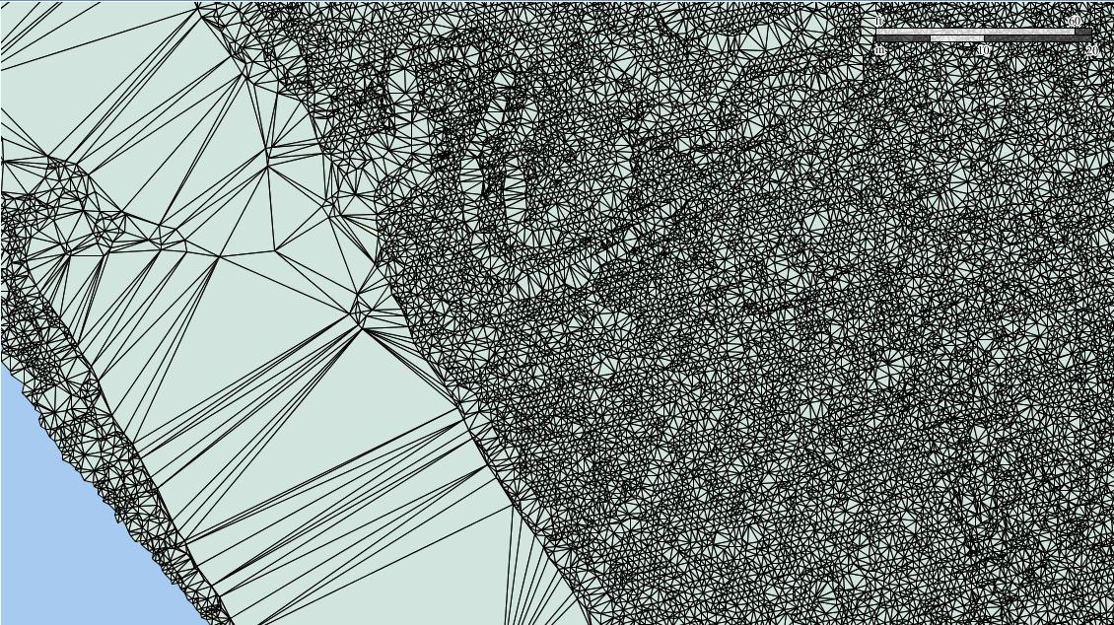
Viewing the Triangles

